Slide 1
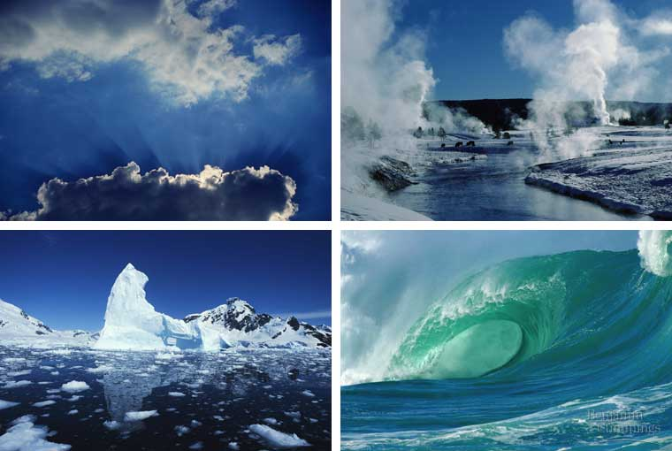
WATER AND HYDROGEN

Slide 2
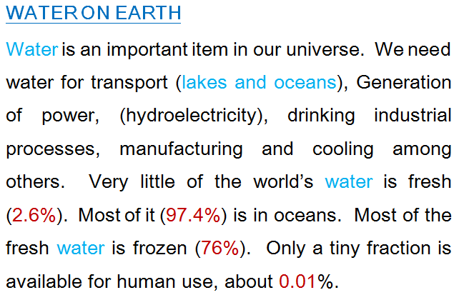

Slide 3
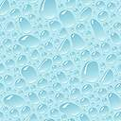
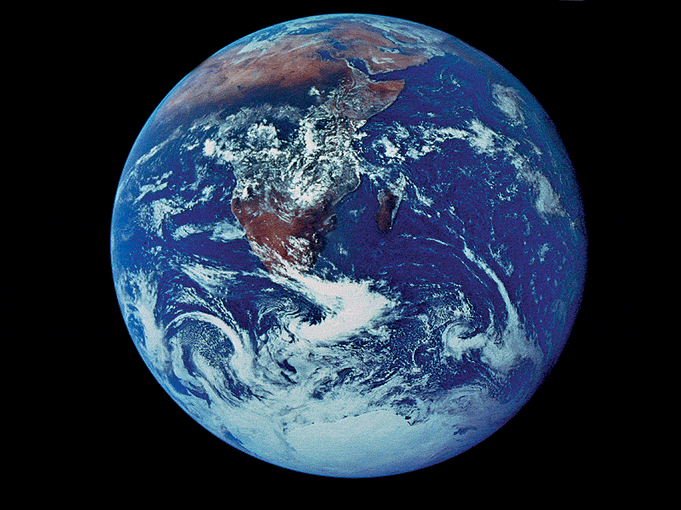
Properties of Water
Polar molecule
Cohesion and adhesion
High specific heat
Density – greatest at 4ºC
Universal solvent of life

Slide 4
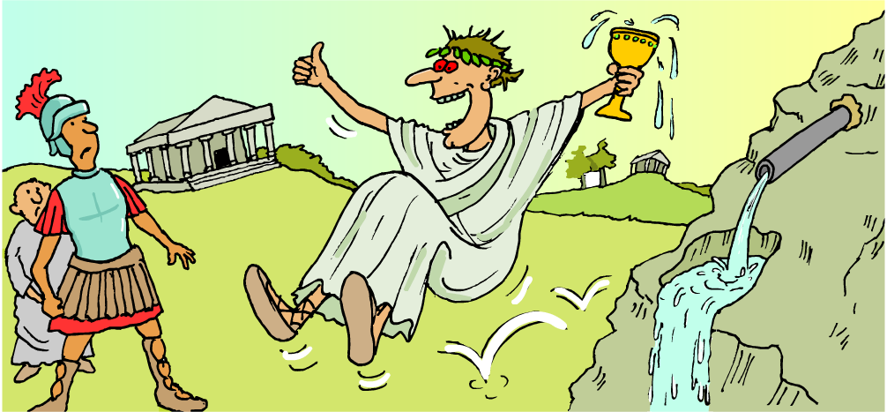
The Romans used lead to make water pipes but didn’t know that lead reacts slowly with water and makes it poisonous!
Some metals react vigorously with water, some metals react slowly and some do not react at all.
What is the best type of metal to use for water pipes?

Slide 5
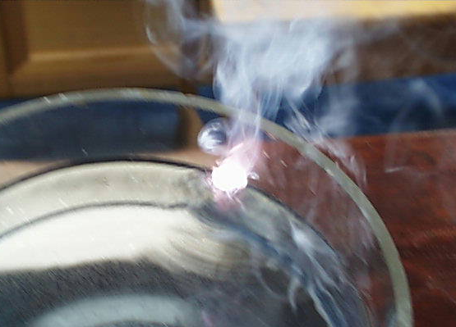
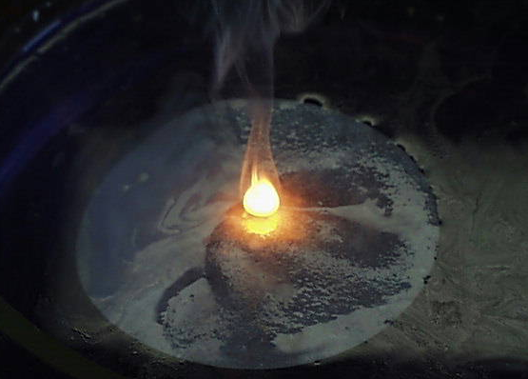
Metals and water – general equation
Potassium and sodium are metals that react vigorously with water even when a small amount of each metal is used.
When a metal reacts with water, the products are a metal hydroxide and hydrogen gas. What is the general equation for the reaction of a metal with water?
metal
water
metal hydroxide
hydrogen
What is the test that a metal hydroxide is produced?

Slide 6
What is the balanced symbol equation for each reaction?
What are the products when each metal reacts with water?
lithium
+
water
➔
lithium hydroxide
+
hydrogen
2Li | + | 2H₂O | ➔ | 2LiOH | + | H₂
sodium
+
water
➔
sodium hydroxide
+
hydrogen
2Na | + | 2H₂O | ➔ | 2NaOH | + | H₂
potassium
+
water
➔
potassium hydroxide
+
hydrogen
2K | + | 2H₂O | ➔ | 2KOH | + | H₂

Slide 7
James investigated how reactive some metals are when they react with water and made these observations.
Metal Reaction with water
lithium
Bubbles of gas are given off quite quickly. When tested with universal indicator the water is now alkaline.
sodium
The sodium melts and skims over the surface producing a stream of small bubbles. Sometimes a yellow-orange flame appeared.
potassium
Potassium immediately produces a lilac flame as it skims around the surface making a fizzing noise.
Which of these metals is the most reactive with water?
Which of these metals is the least reactive with water?

Slide 8
James investigated how reactive other metals are with water and made these observations.
Metal Reaction with water
magnesium
Reacts slowly with cold water but reacts quickly with steam.
copper
No reaction.
silver
No reaction.
gold
No reaction.
Copper is used in plumbing and silver and gold in jewellery.
Why are these unreactive metals suitable for such uses?

Slide 9
Metals and water – order of reactivity
Put the following metals in order of reactivity based on their reaction with water, starting with the most reactive:
copper, gold, magnesium, lithium, potassium, silver, sodium.
potassium
sodium
lithium
magnesium
copper, silver, gold

Slide 10
Identifying Water
1. Test with anhydrous copper(II) sulphate Water will change the colour of anhydrous copper(II) sulphate from white to blue.
2. Test with anhydrous cobalt(II) chloride Water will change the colour of dry cobalt(II) chloride paper from blue to pink.
Note that these two tests only show the presence of water.
They cannot be used to test for the purity of water.

Slide 11
Combustion results in the formation of both carbon dioxide & water
When substances burn, reacting with oxygen, the new products formed are called oxides
Carbon + Oxygen → Carbon Dioxide
Hydrogen + Oxygen → Water
Methane (CH₄) is often used in cooking (it contains both carbon & hydrogen)
When it is burnt in oxygen it produces the following products: -
Methane + Oxygen → Carbon Dioxide + Wate

Slide 12
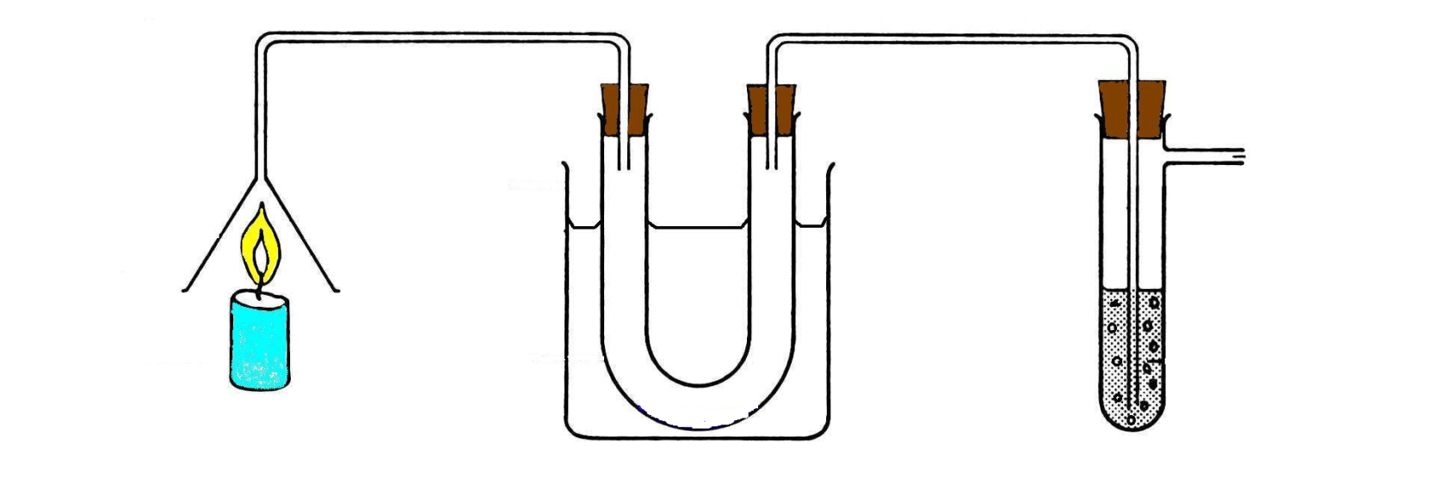
The apparatus below was used to test the products of combustion of a hydrocarbon.
Suction
pump
ice-
water
Lime water
Goes Milky
The hydrocarbon
is burned here
e.g. candle wax.
Liquid collected
can be tested with
anhydrous cobalt chloride
paper. Turns Pink

Slide 13
Hydrocarbon fuel | Effect on cobalt chloride paper | Effect on limewater
methane | blue | clear
paraffin | blue | clear
kerosene | blue | clear
coal | blue | clear
candle wax | blue | clear
pink
cloudy
pink
cloudy
pink
cloudy
pink
cloudy
pink
cloudy
any hydrocarbon + oxygen ➔ water + carbon dioxide

Slide 14
Incomplete Combustion
When there is not enough oxygen for complete combustion to occur, incomplete combustion takes place.
methane + oxygen
carbon monoxide + water
CH₄ + O₂
CO + H₂O
methane + oxygen
carbon + water
CH₄ + O₂
C + H₂O
Balance the equations

Slide 15
HYDROGEN
Laboratory Preparation of Hydrogen

Slide 16
Hydrogen is prepared in the laboratory by the action of acids on
metals.
Dilute hydrochloric acid containing 1 volume of concentrated acid to
4 volumes of water, is added to granulated zinc.
Zinc chloride is formed in solution and the hydrogen that is evolved is
collected over water in a trough.
Since hydrogen is very much lighter than air and insoluble it may also be
collected by downwards displacement of water

Slide 17
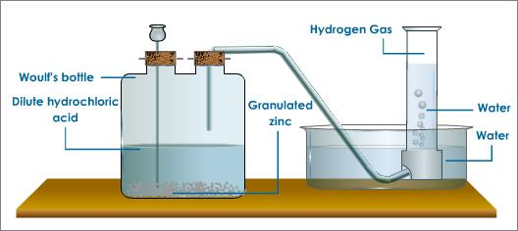

Slide 18
Properties
Hydrogen is;
a colourless odourless gaseous element,
sparingly soluble in water and the solubility is not much affected by
change of temperature,
Does not support respiration although it is not poisonous.
When hydrogen is breathed mixed with some air for a short time,
it weakens the voice and raises its pitch,
Forms compounds with a large number of elements. In many cases,
these compounds are formed by the direct combination of the elements.
Chemically, hydrogen reacts with most elements.

Slide 19
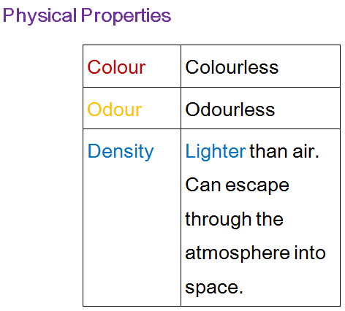

Slide 20
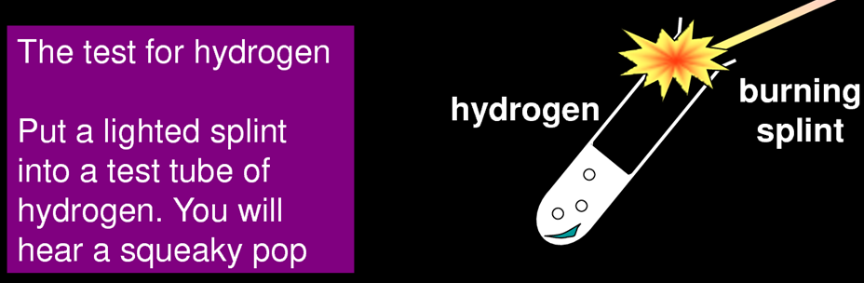

Slide 21
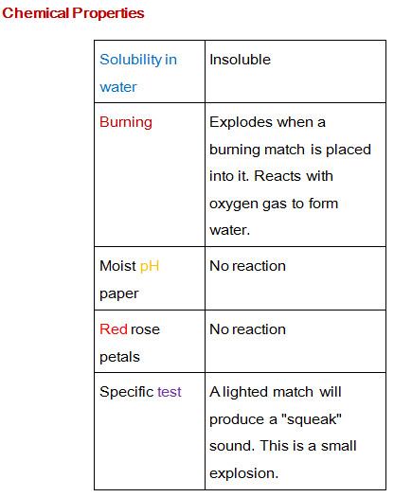

Slide 22
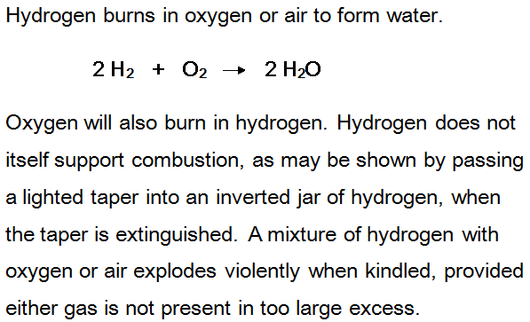

Slide 23
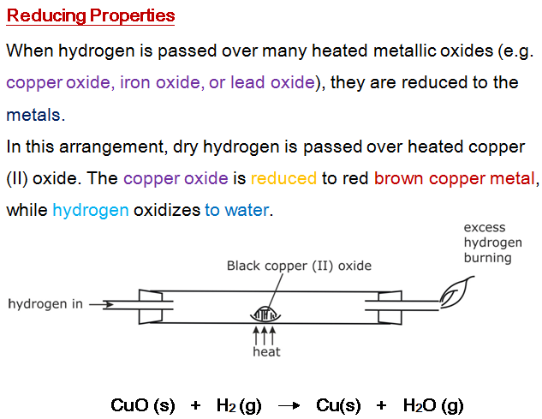

Slide 24
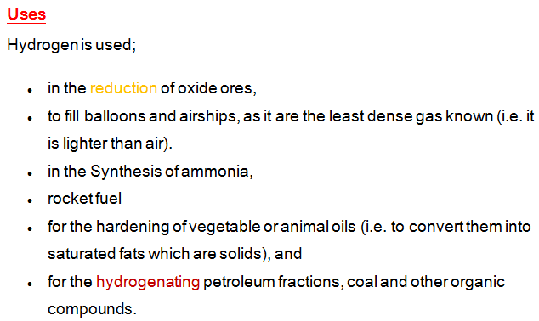

Slide 25
